Slide 1
Scientific Machine Learning and Tensorflow tutorial
Operator Learning
Ravi G Patel
Scientific Machine Learning Department
February 1 – 2, 2024
Numerical PDEs: Analysis, Algorithms, and Data Challenges
ICERM
Brown University
SAND2024-00936O

Slide 2
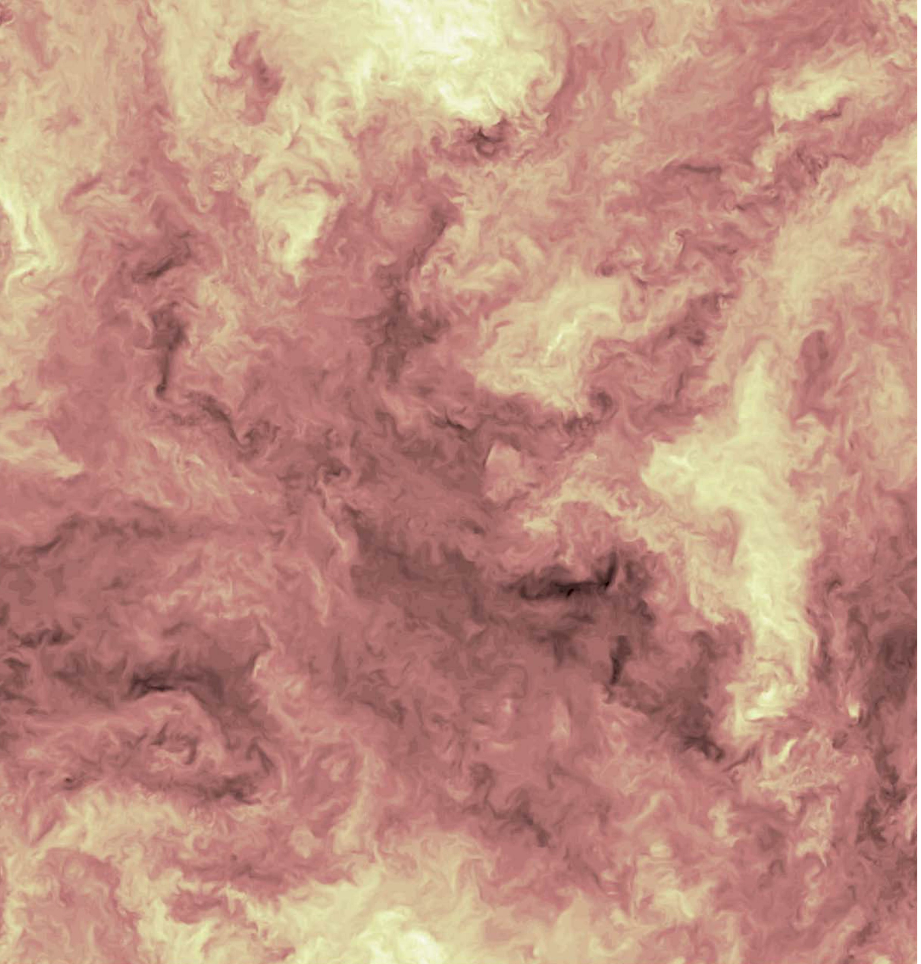
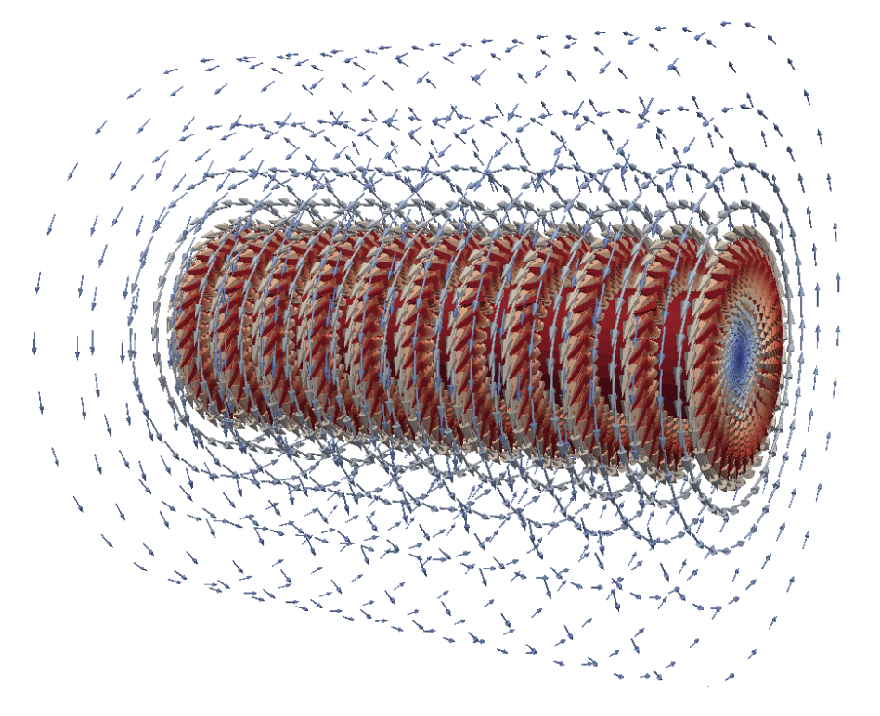
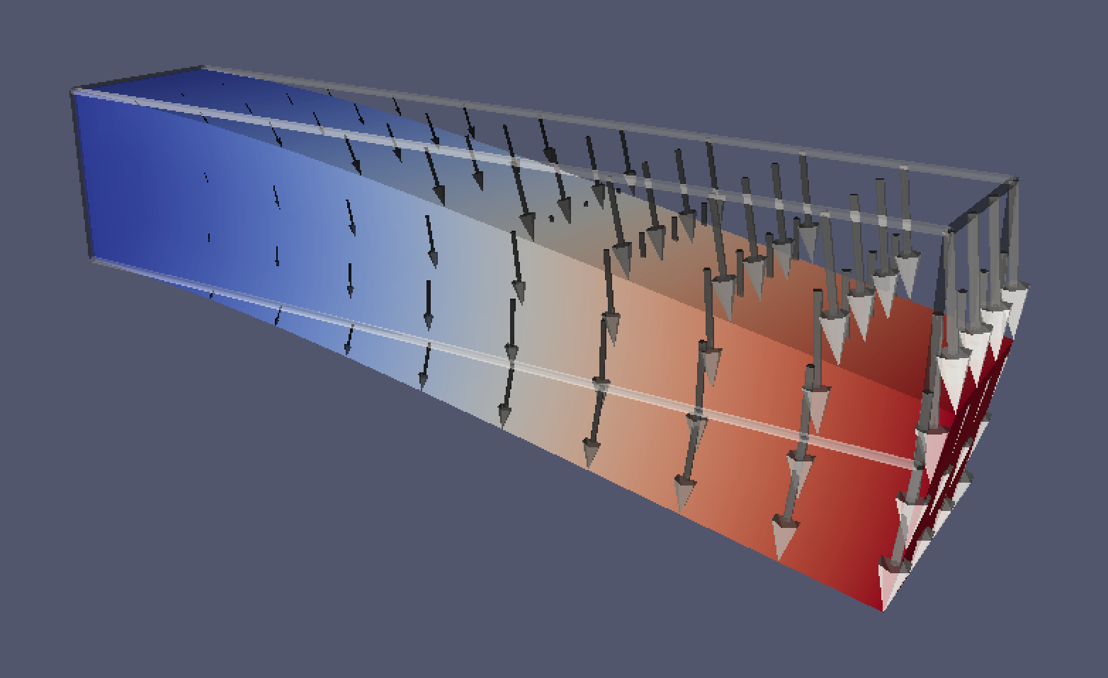
Physical systems are described by PDE’s
We describe many physical systems with fields, i.e., functions over a spatio-temporal domain
When we model field data, we’re trying to find a unknown PDE
An equation with field valued solutions that match our data
Historical examples,
Physics | Incompressible fluid | Electromagnetism | Elasticity
Fields | Fluid velocity | Fluid velocity | Stress/strain
PDE | Navier-Stokes | Electric/magnetic | Hook’s Law
Forced isotropic turbulence JHTDB, turbulence.pha.jhu.edu
Magnetic field from oscillating current Elmer FEM, elmerfem.org
Cantilever bean under gravity FENICS, fenicsproject.org

Slide 3
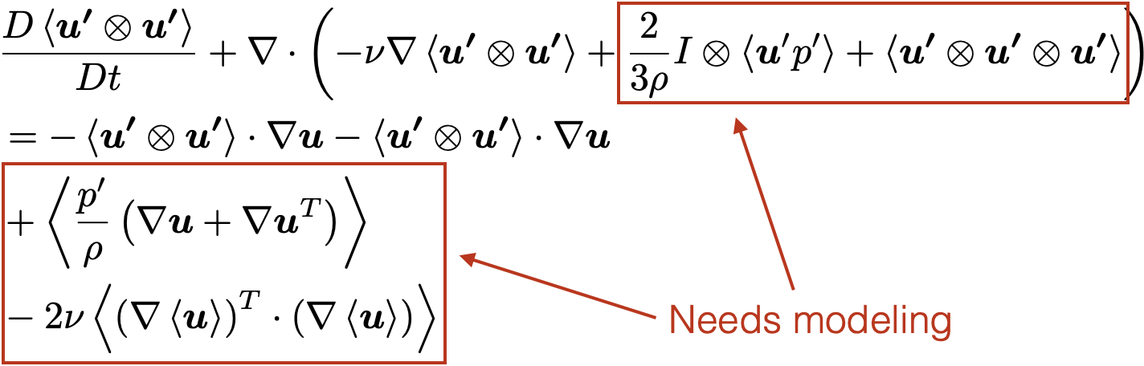
PDE modeling is hard
Multiphase, multiphysics problems
Can’t easily model with intuition
Data driven methods provide an alternative
Reynolds stress modeling for single phase turbulence
Forced isotropic turbulence JHTDB, turbulence.pha.jhu.edu

Slide 4
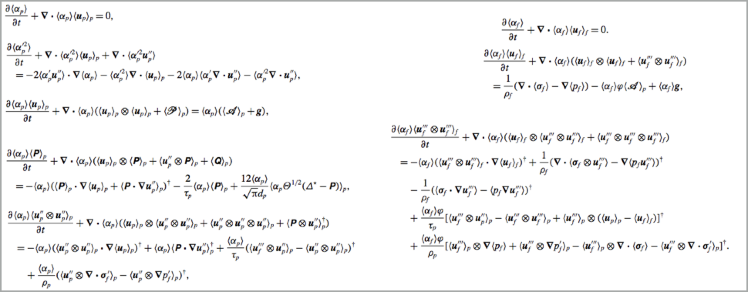
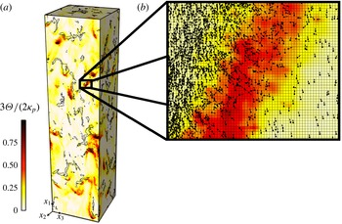
PDE modeling is hard
Multiphase, multiphysics problems
Can’t easily model with intuition
Data driven methods provide an alternative
Granular temperature field in cluster-induced turbulence¹
Reynolds averaged transport equations¹ for particle-laden turbulent flow
¹Capecelatro et al., J. Fluid Mech. (2015)

Slide 5
PDE modeling is hard
Adding a single extra phase greatly complicates the model
Need a scalable approach to PDE modeling
Multiphase, multiphysics problems
Can’t easily model with intuition
Data driven methods provide an alternative
Granular temperature field in cluster-induced turbulence¹
Reynolds averaged transport equations¹ for particle-laden turbulent flow
¹Capecelatro et al., J. Fluid Mech. (2015)

Slide 6
Operator learning enables PDE discovery
PDE’s are composed of operators, i.e., mappings between functions,
E.g., the viscous Burger’s equation has three operators,
If we’re given the field data, we can find a PDE by finding it’s component operators

Slide 7
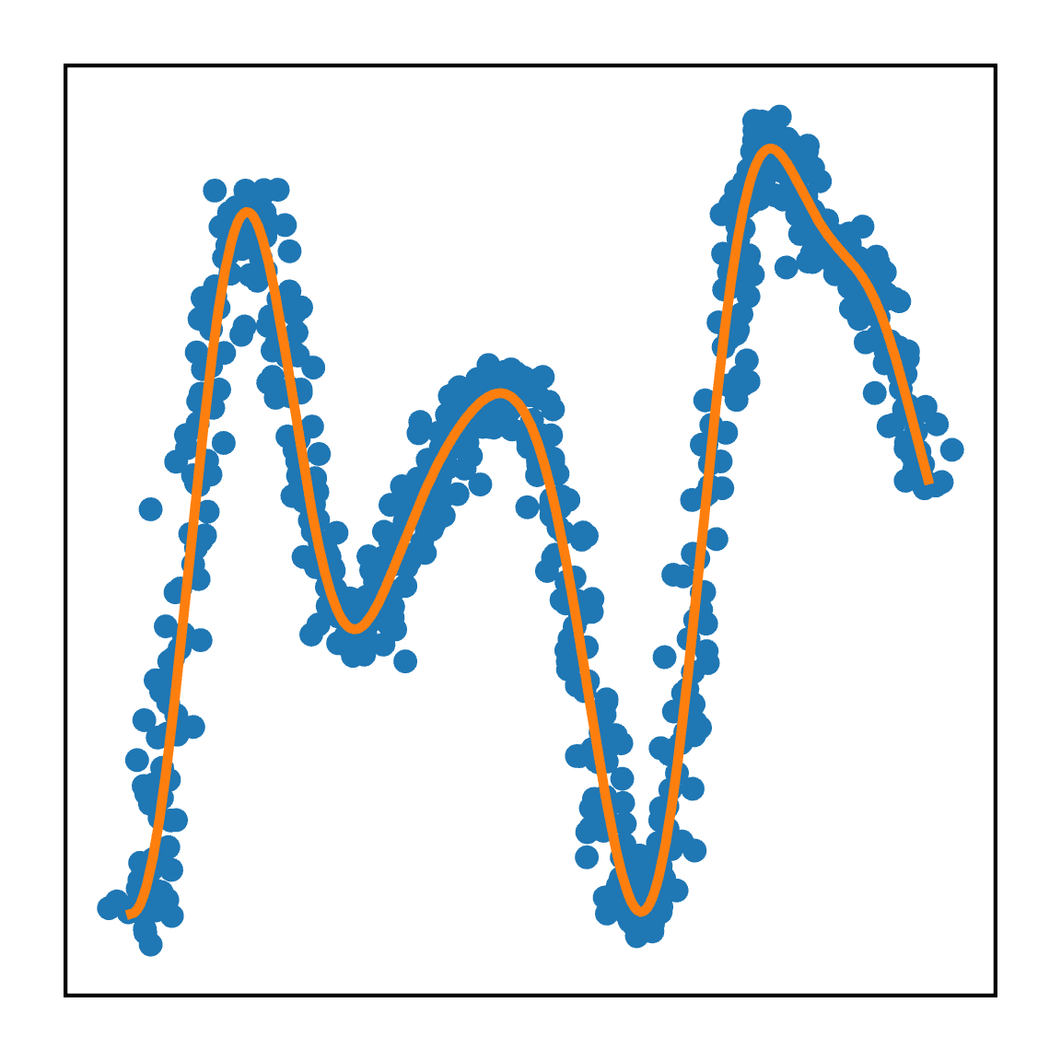
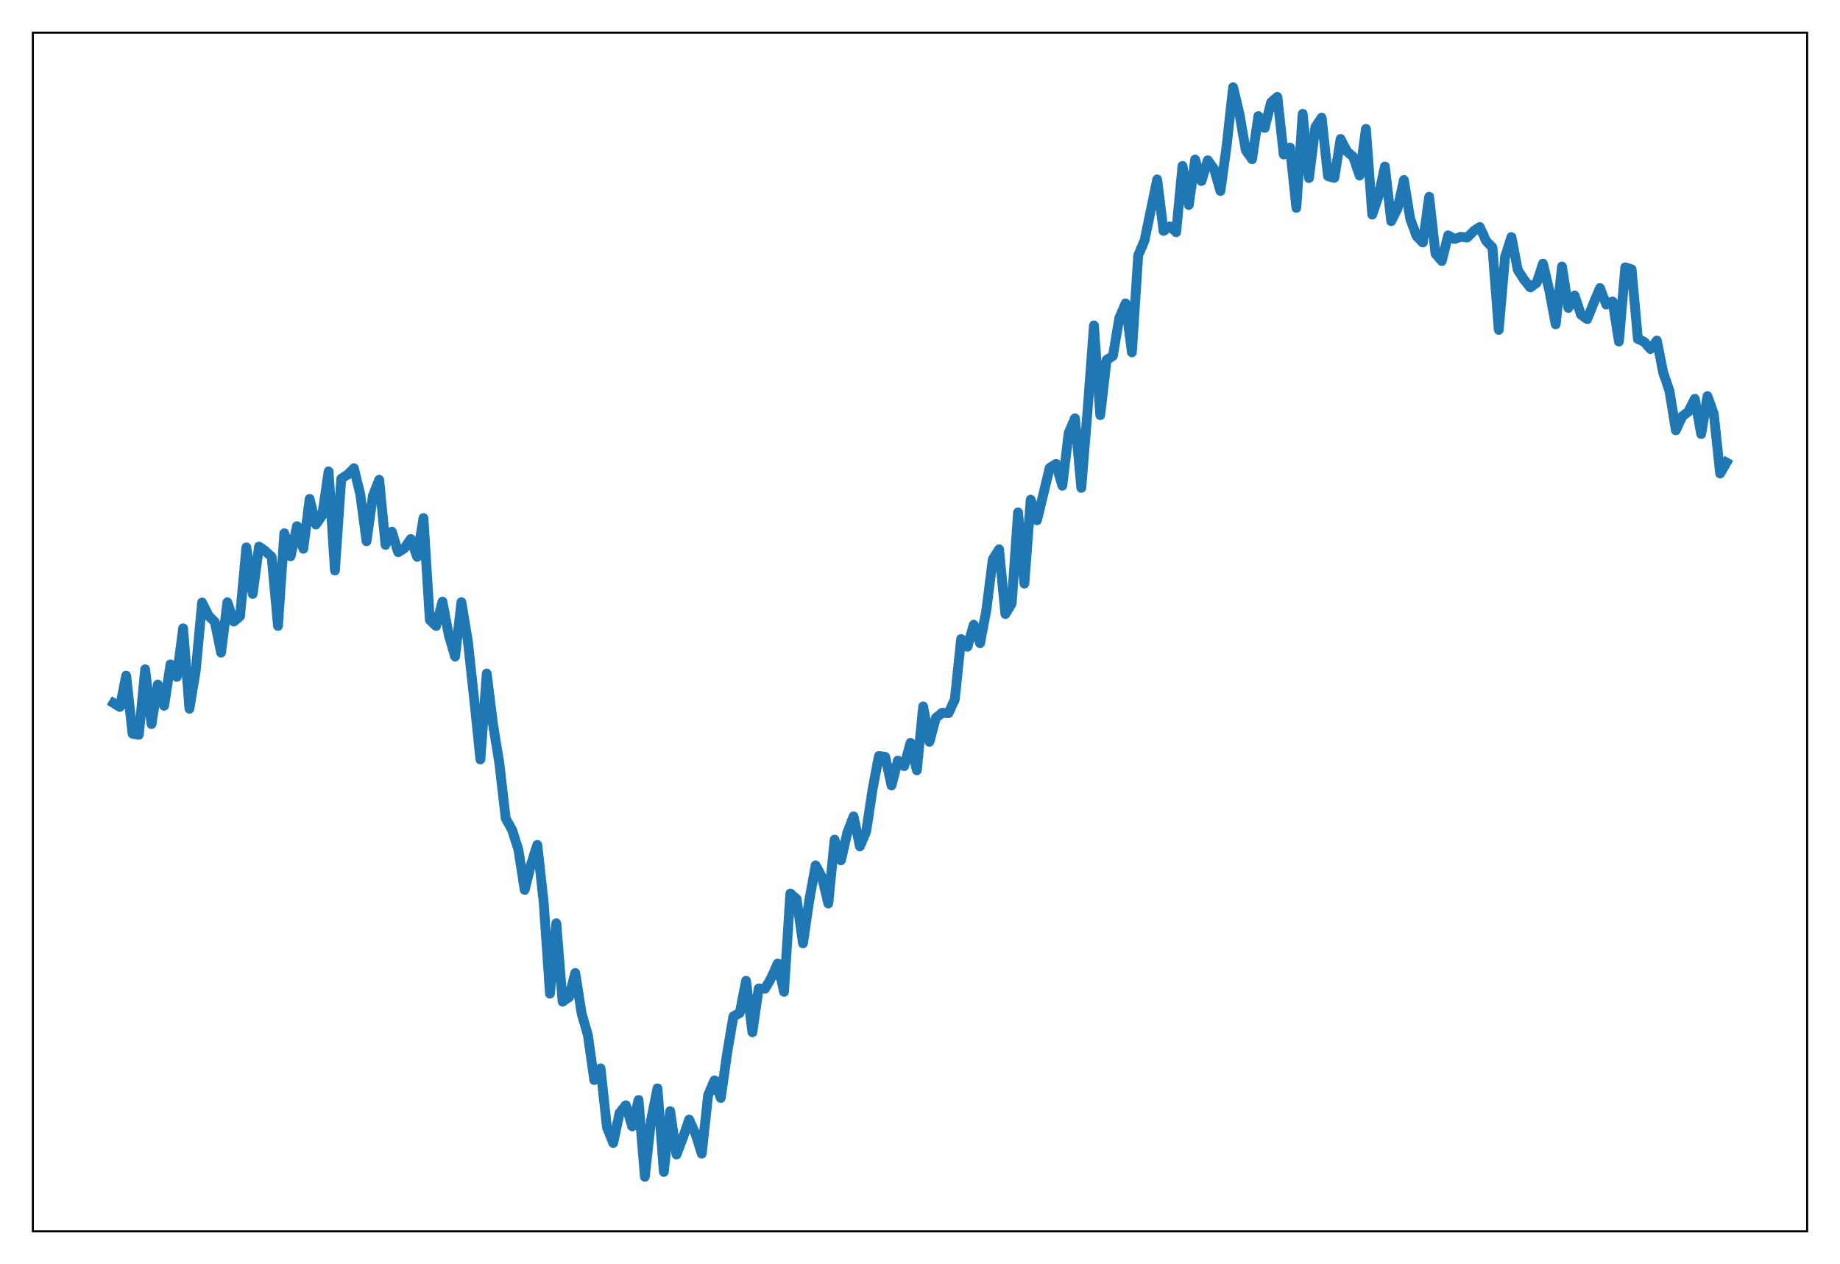
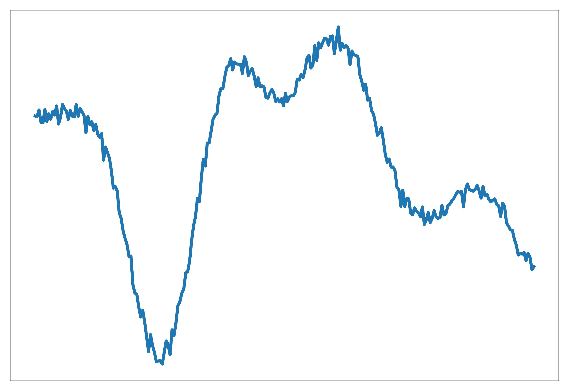
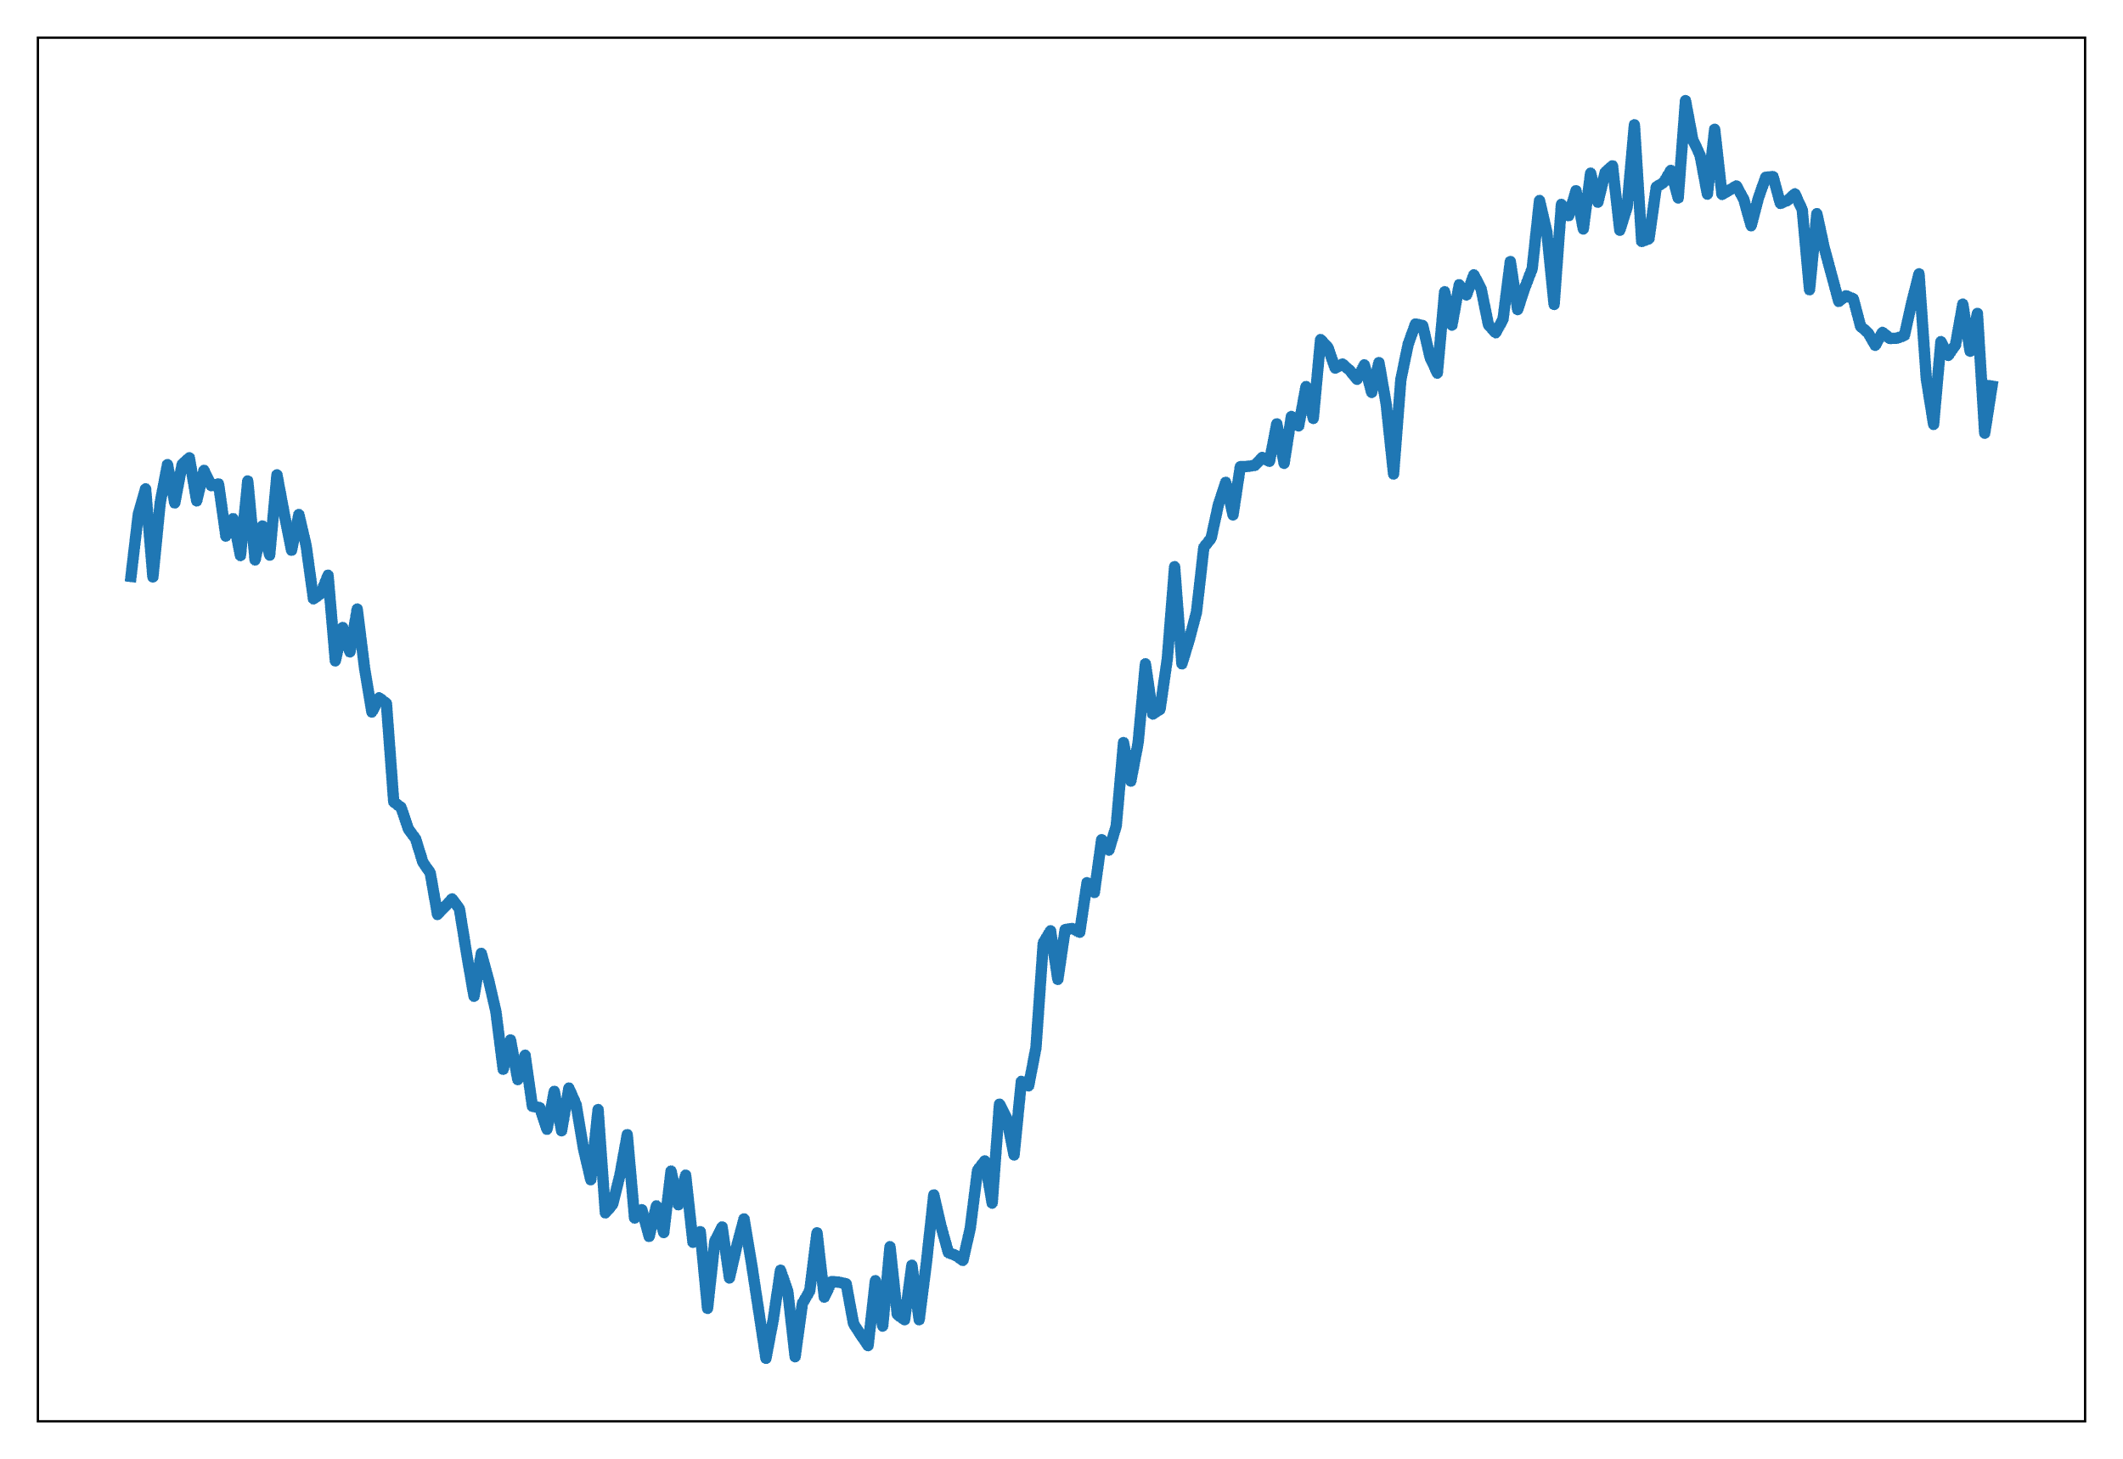
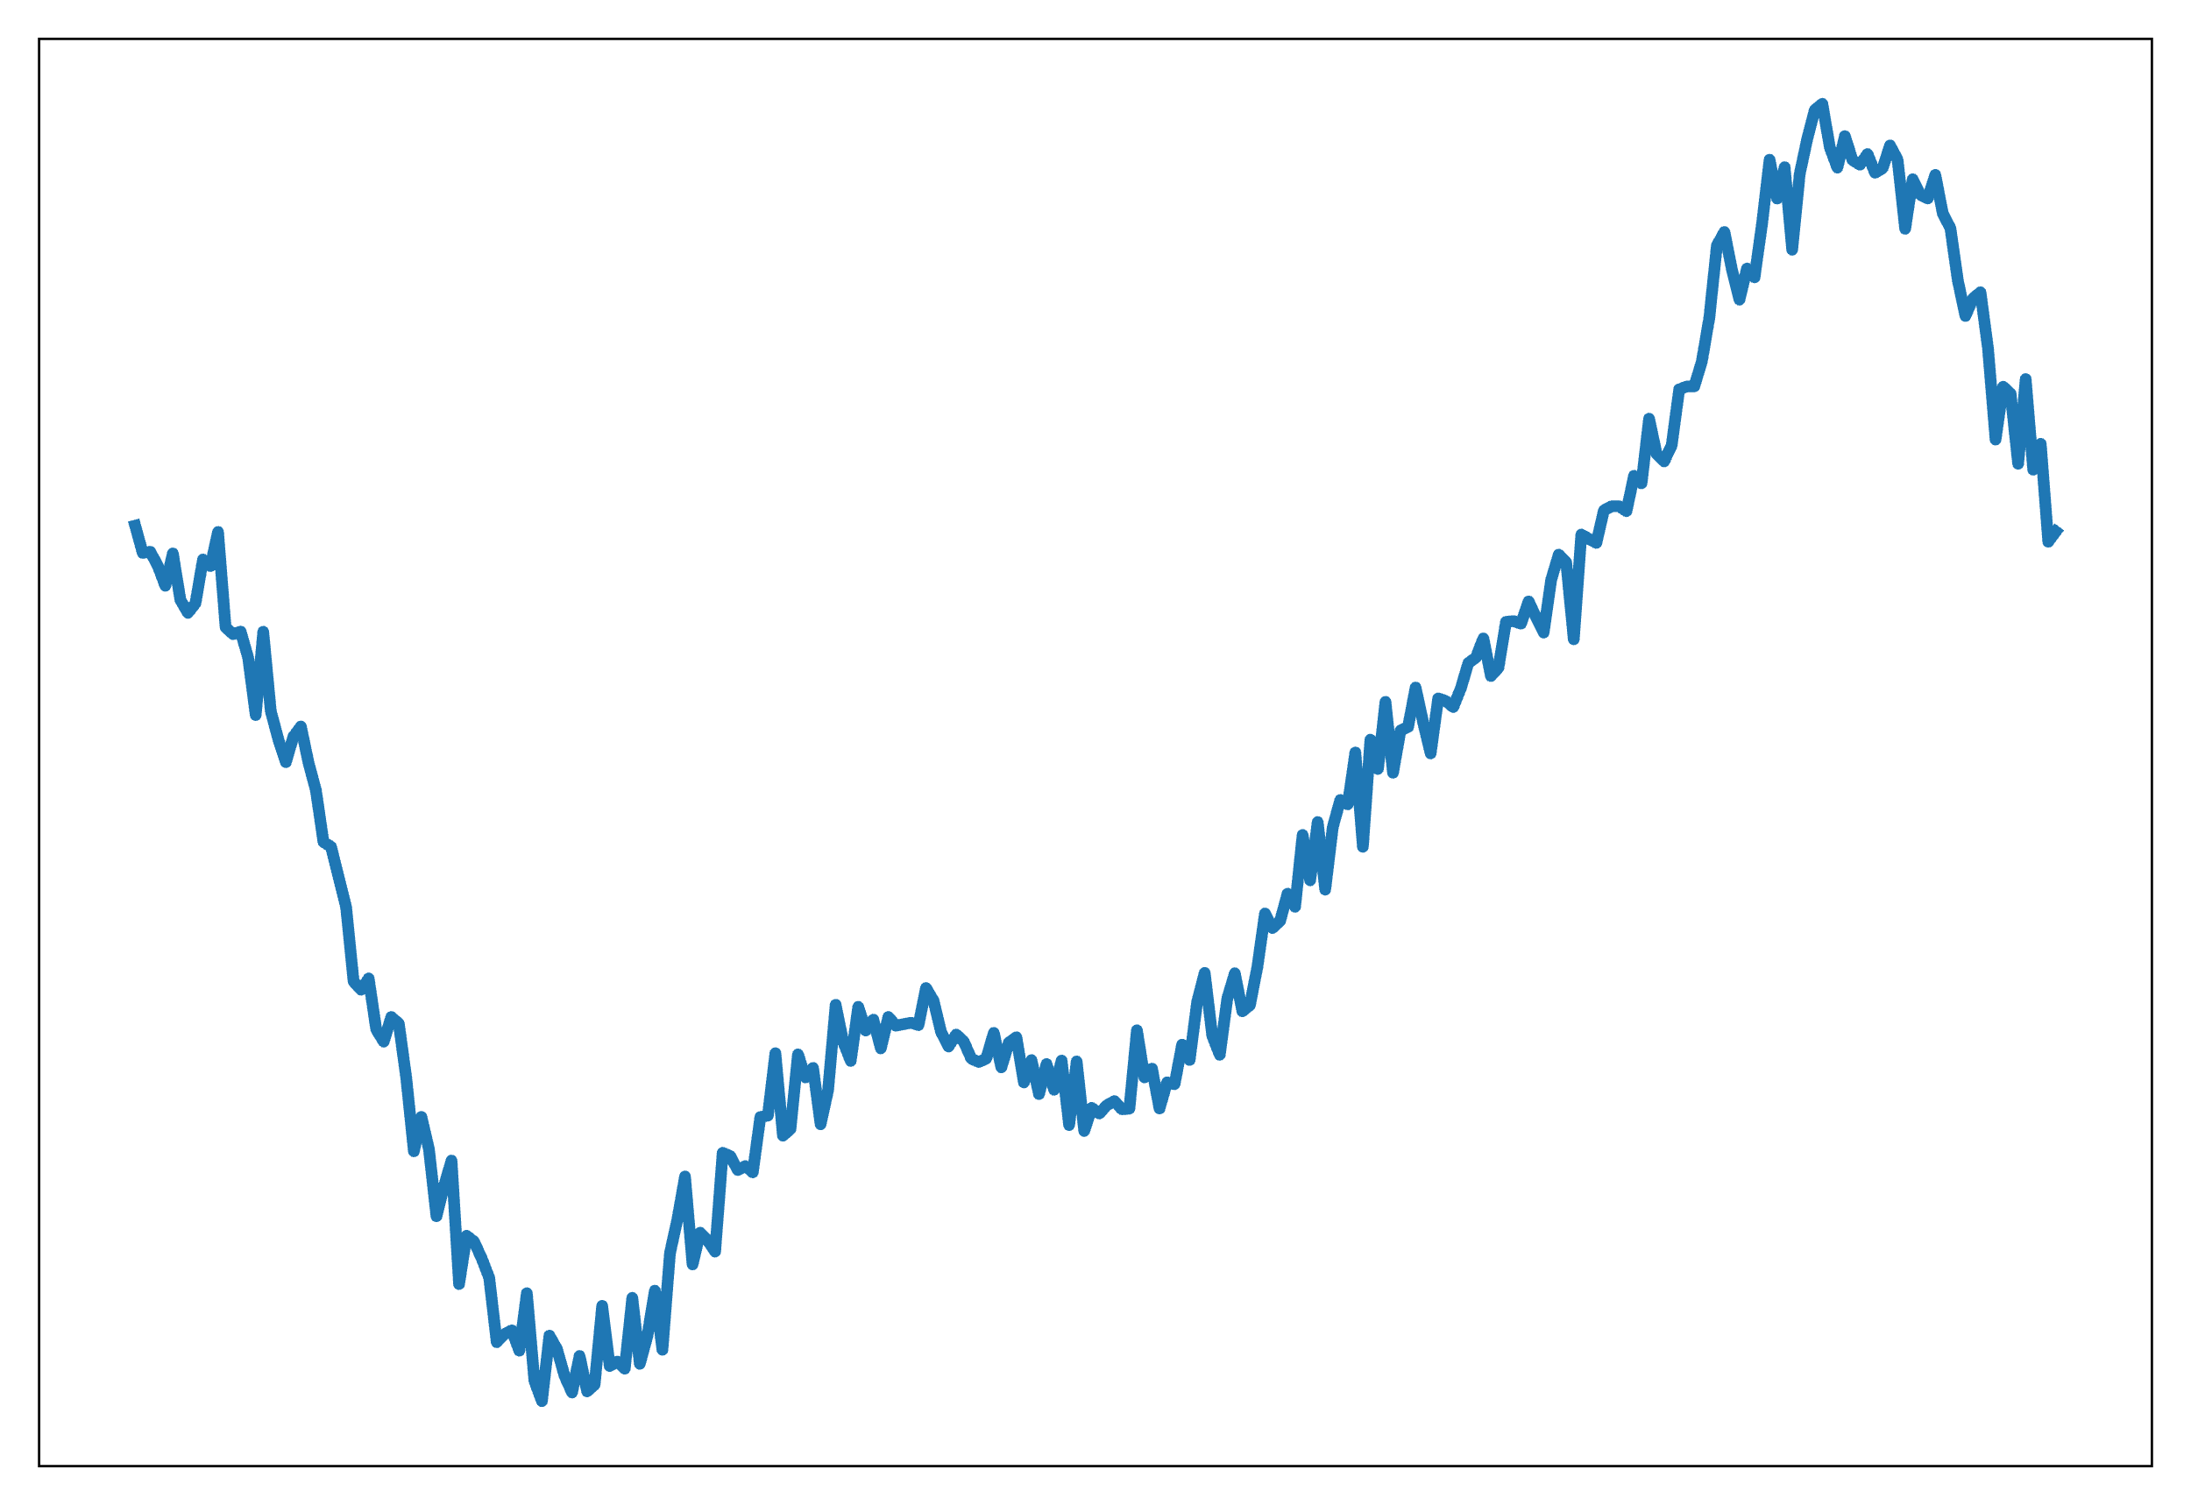
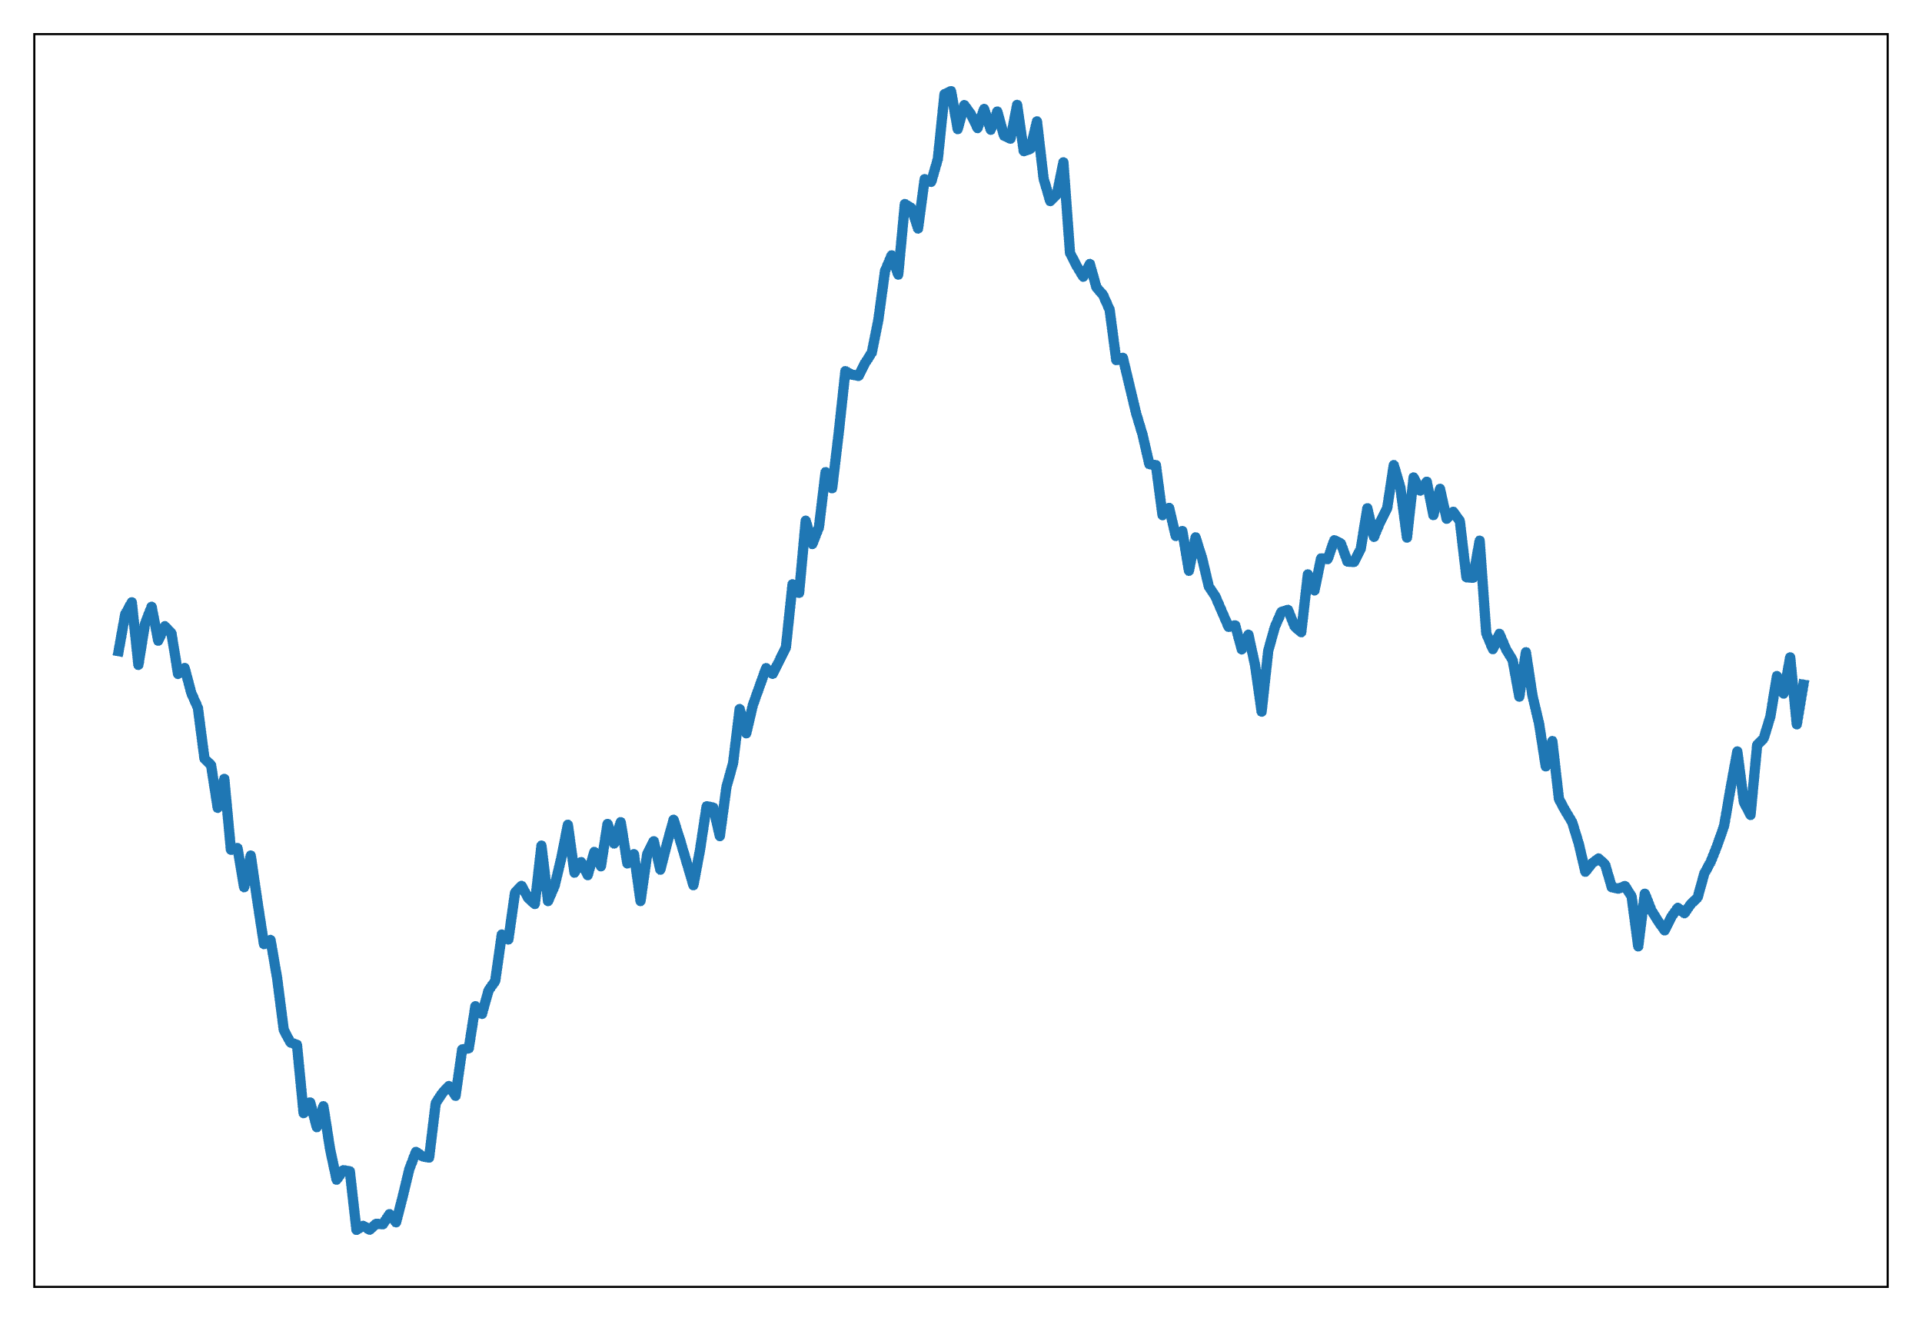
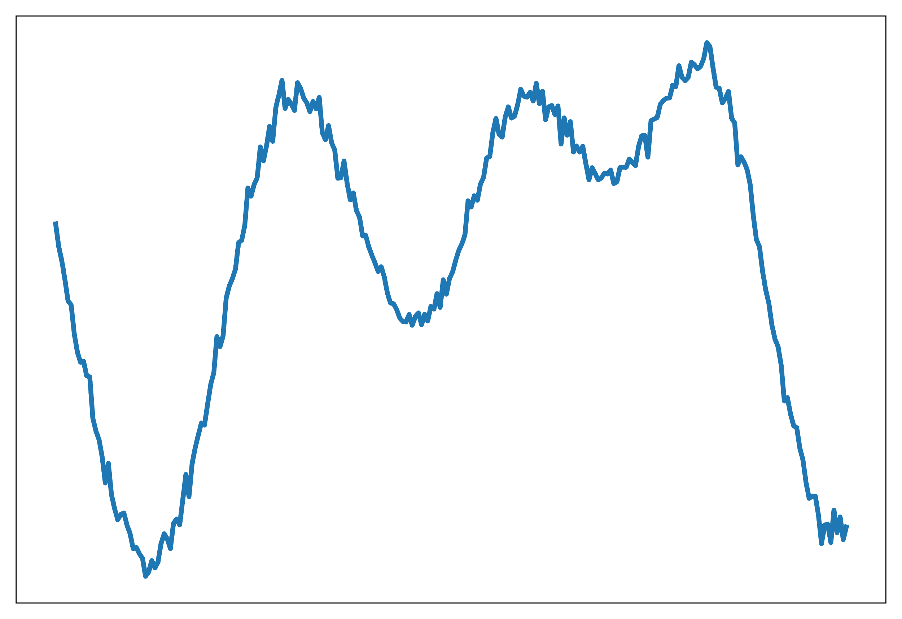
Operator learning is a generalization of regression
Given pairs of functions, , we can use regression to find the operator maps between the two,
Fitting functions
Fitting operators

Slide 8
Three Components of an operator learning method
A discretization for functional data
To run on computers, we need to work with some discretization
Usually implicit in the dataset we receive
Often taken to be point evaluations of the functions
An interpolation scheme
Even though we only work with discretizations, we should be able to evaluate the functions anywhere they’re defined
Can be learned or fixed
A parameterized mapping between discretizations
We’ll use gradient based methods to optimize these parameters against the error norm

Slide 9
Operator learning parameterizations
Modal operator regression for physics (MOR-Physics^{1,2})
Given pairs of functions, , let’s find a Poisson-like PDE,
Let’s assume they’re given as point-wise evaluations on a regular, periodic grid
We parameterize the unknown operator as,
Where and are neural networks. is the Fourier transform
Optimization problem becomes,
¹R.G. Patel and Desjardins, arxiv: 1810.08552 (2018)
²R.G. Patel et al., CMAME (2021)

Slide 10
MOR-Physics: motivation
For smooth functions in a periodic domain,
Physical space
Fourier space
Parameterization contains,
Laplacian
Burgers operator

Slide 11
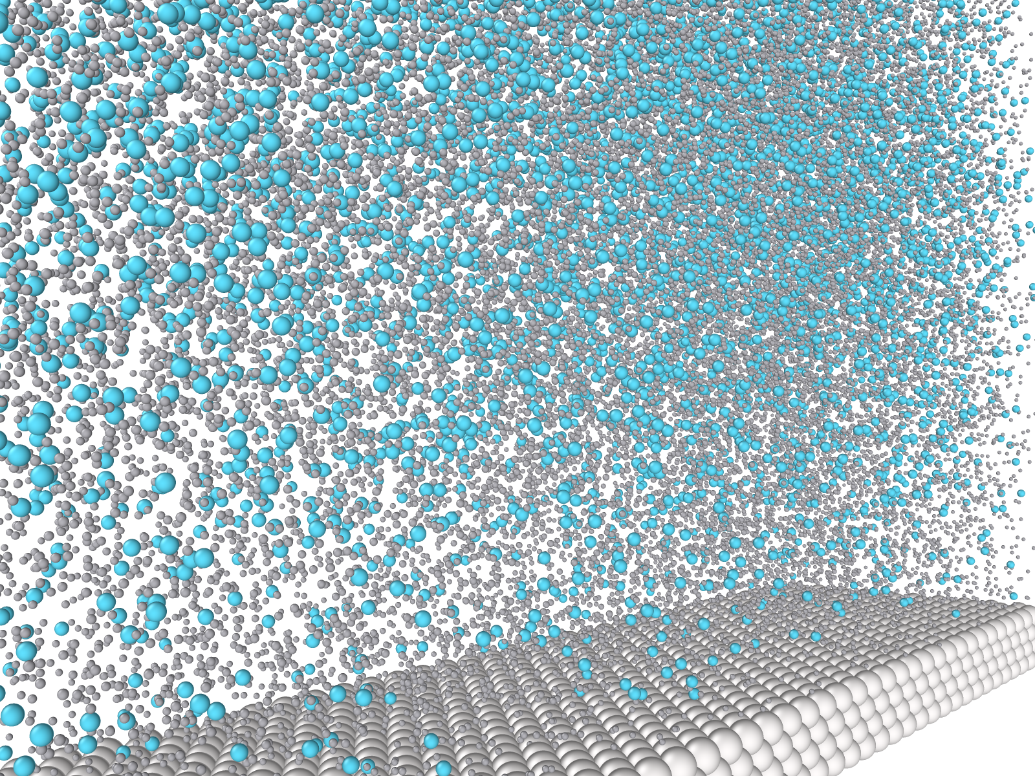
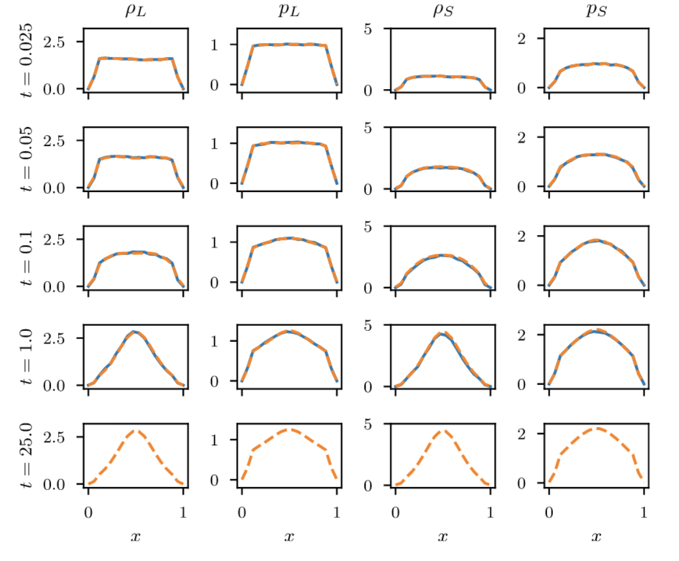
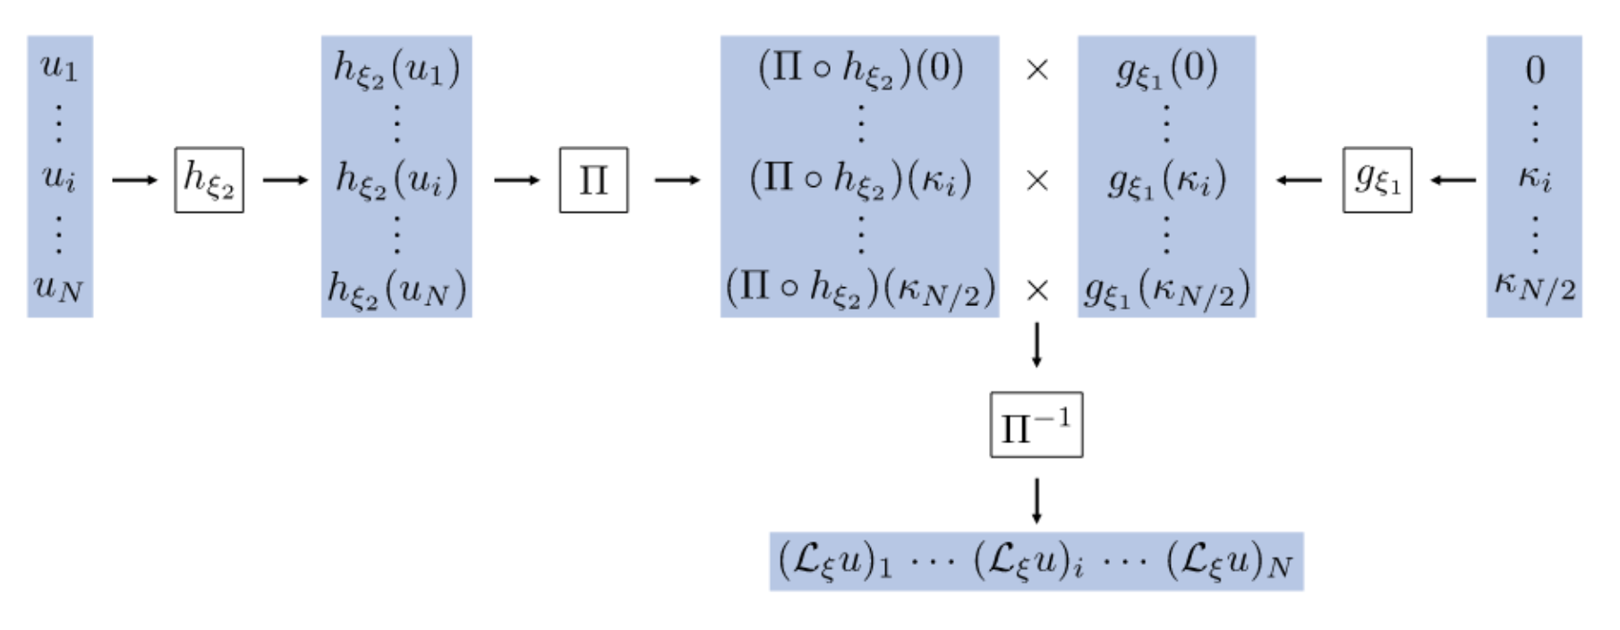
MOR-Physics: Example
MOR-Physics parameterization¹
MOR-physics learns dynamics of colloidal system from molecular dynamics simulations. Generalizes to unseen concentration and colloid diameter²
¹R.G. Patel and Desjardins, arxiv: 1810.08552 (2018)
²R.G. Patel et al., CMAME (2021)

Slide 12
Operator learning parameterizations
Deep Operator Network (DeepONet)¹
Given pairs of functions, , let’s find a Poisson-like PDE,
Let’s assume they’re given as point-wise evaluations on two (possibly different) sets of collocation points
We parameterize the unknown operator as,
Where and are neural networks
Optimization problem becomes,
¹Lu, Jin and Karniadakis, Nature, 2021

Slide 13
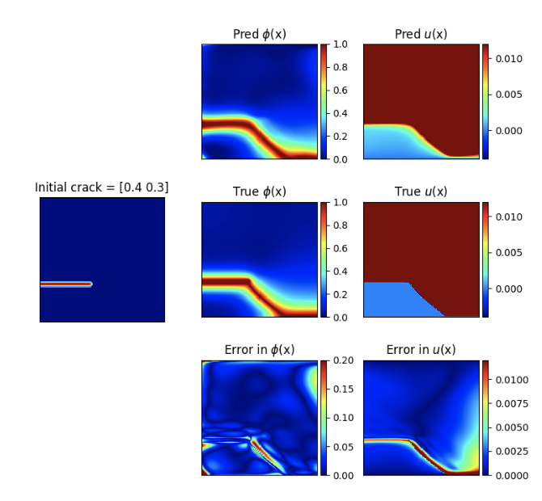
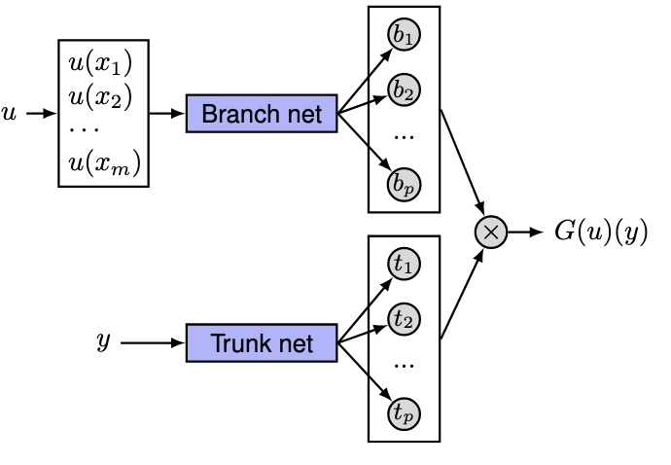
DeepOnet example
Unstacked DeepONet parameterization
Variational DeepONet learns crack path under shear loading. Generalizes to unseen crack tip locations.²
¹Lu, Jin and Karniadakis, Nature, 2021 ²Goswami et al., CMAME, 2022

Slide 14
Including a priori knowledge
Operator learning is flexible
Can learn several operators simultaneously
Can combine a partially known PDE with unknown operators
Often, we’ll know more about a system than just that the data
Theoretical results
Symmetries
Conservation principles

Slide 15
Time evolving systems
Assume system is described by 1st order in time, autonomous PDE,
Discretize in time,
Given observations, , find,
More generally,

Slide 16
Time evolving systems
Alternatively, parameterize your operator with time
Lu, Jin and Karniadakis, Nature, 2021
Li et al., ICLR (2021)

Slide 17
Other operator learning frameworks and Related methods
Fourier Neural Operator
Li et al., ICLR (2021)
Nonlocal operator regression
H. You et al., CMAME (2020)
Operator Inference
B. Peherstorfer and K. Willcox, CMAME (2016)
Function-to-function regression
J.S. Morris, Annu. Rev. Stat. Appl. (2015)

